Slide 1
Node.js Workshop for backend
Session 1 : Introduction to Node.js

Slide 2
Workshop timeline
Session 1
Session 2
Session 3
Introduction to Node.js and NPM
HTTP protocol - REST APIs - Express.js
MVC - Database
Session 4
Session 5
Web Security and User Authentication
Testing and Deployment

Slide 3
Table of contents
02
04
05
01
03
Intro to Backend
Intro to Node.js
Install Node.js
What is Backend
What is Node.js and why we use it
Install and try to run JS outside the browser
How Js works
Package manager
The internals of Javascript
NPM – What is package manager and why we use it

Slide 4
01
Intro to Backend
What is Backend?

Slide 5


Client-server architecture
server
client
request
response

Slide 6
What is Backend?
The backend is the part of a website or application that is hidden from the user.
It is responsible for storing data, processing requests, generating responses, and communication with other services.

Slide 7


Backend example
Ecommerce website: i.e.,. Amazon.com
How do you access Amazon’s website ?
Type https://www.amazon.eg in URL bar
Your browser sends request to amazon’s servers to retrieve their web page.
The server respond with the web page then the browser render it.

Slide 8


Backend example cont.
What happens when you buy something?
You click on the “Buy” button.
The server retrieves the product information from the database.
Server calculates the total price of the order.
Server sends the payment information to the payment gateway.
Server processes the payment and update the order status.
Server sends the shipping information to the shipping carrier.

Slide 9

02
Intro to Node.js
What is Node.js and why we use it?

Slide 10

What is Node.js?
Node.js was created by Ryan Dahl in 2009 to address the limitations of existing web development platforms.
Node.js is an open-source, cross-platform, single-threaded runtime environment that executes JavaScript code outside of a web browser.
Node.js uses an event-driven, non-blocking I/O model that makes it lightweight and efficient.

Slide 11


Open-source
Open-source software is software that anyone can see, change, and use for free.
It's developed and maintained by a community of developers who work together to make it better.
This makes open-source software more secure, feature-rich, and supported than closed source software.
Examples of open-source:
Linux
MySQL
Firefox

Slide 12
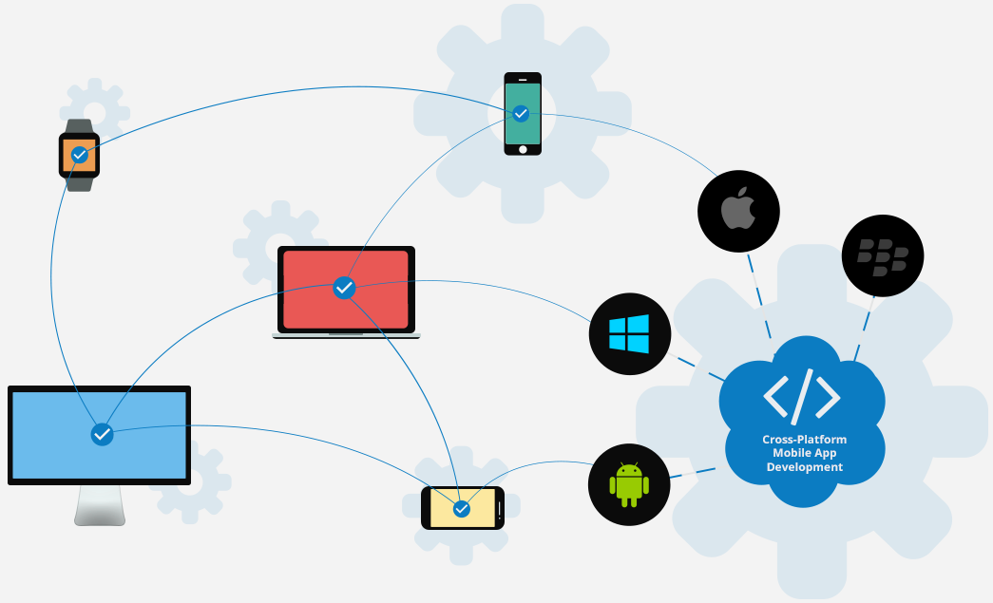
Cross-platform
Cross-platform development allows developers to write code once and deploy it to multiple platforms.
Cross-platform development makes it easier to reach a wider audience.
Cross-platform development can simplify the maintenance process.

Slide 13

Single-Threaded
Cashier at a supermarket
Cashier is the single thread, and the customers are the tasks or functions that need to be executed.
The cashier can only serve one customer at a time.

Slide 14
Single-Threaded
Cashier at a supermarket
Some customers may have special requests that take longer to process.
Applying a coupon or paying with bank check.

Slide 15
Non-blocking
Cashier at a supermarket
To avoid this problem, the cashier can use a technique called asynchronous handling.
The cashier can assign some of the special requests to other workers or services.
Continue serving the next customer while waiting for the results.

Slide 16
Event-driven
Cashier at a supermarket
When the cashier receive the results from the other workers or services.
The cashier can then resume serving the customer who made the special request.

Slide 17
Returning to Node.js
This is similar the single-threaded runtime.
It can use asynchronous programming to handle tasks or functions that involve waiting for external resources.
Such as network requests, database queries, timers, or events.
Is there a case where this approach fails?

Slide 18
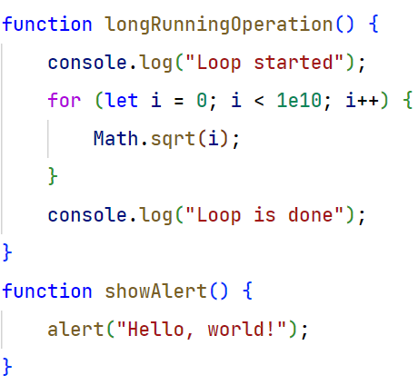
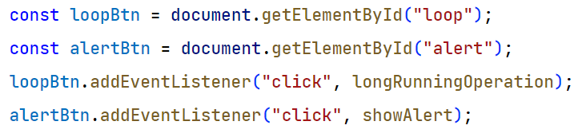
Single-Threaded Event-driven example

Slide 19
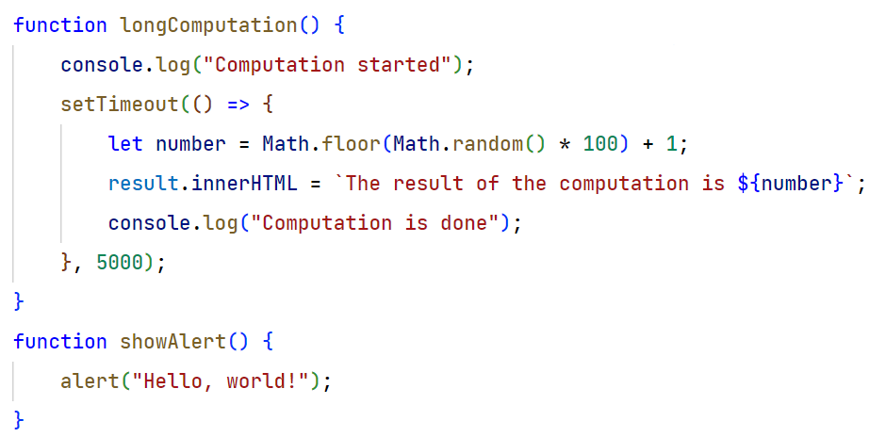
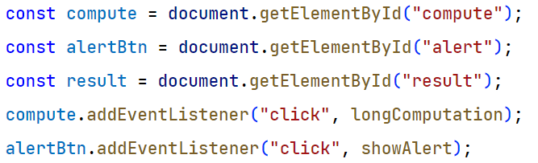
Non-blocking Event-driven example

Slide 20
03
Install Node.js
Install and try to run JS outside the browser

Slide 21
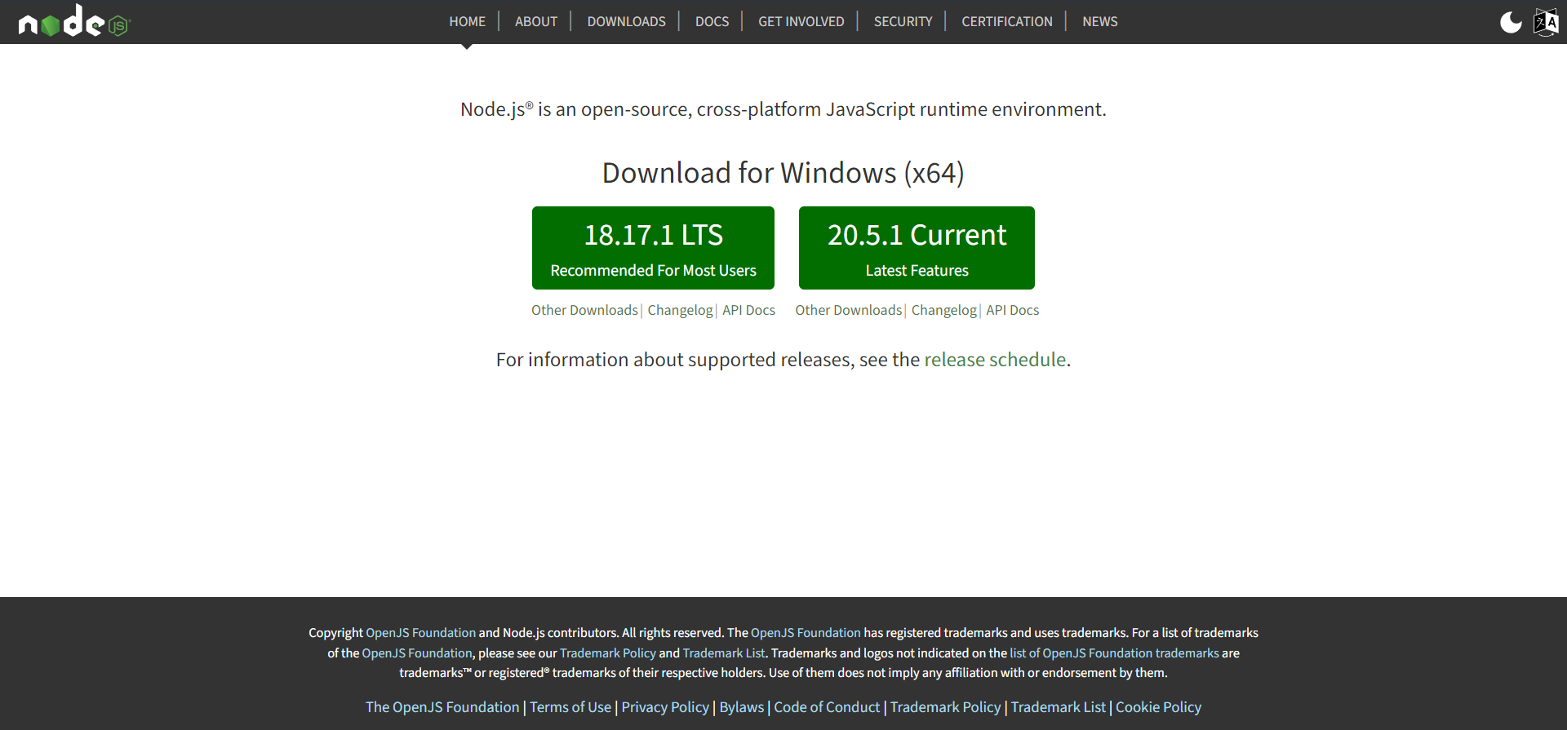
Node.js installation

Slide 22

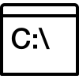
Command line basics
ls Utility that is used to list the contents of a directory
cd
Utility that is used to change the current working directory in a terminal or console
pwd
Utility that is used to print the current working directory

Slide 23

Module system
A module system is a way of organizing and structuring code into reusable and independent units.
CommonJs (Node.js only)
ESModules

Slide 24
Core modules
The core modules are built-in and do not require any installation.
Some of the most famous Node.js core modules are:
fs: This module allows you to work with file system operations. You can use it to read, write, delete, or modify files and directories.
crypto: This module allows you to perform cryptographic operations, such as hashing, encryption, decryption, signing, and verifying. You can use it to secure your data and communication.
http: This module allows you to create and interact with HTTP servers and clients. You can use it to handle requests, responses, headers, cookies, and more.

Slide 25
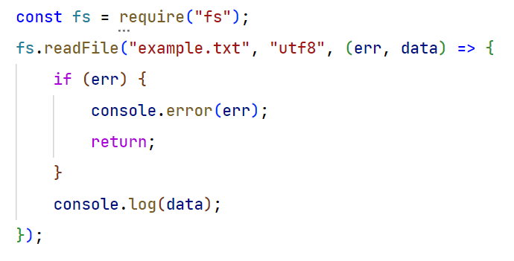
fs example (callback)

Slide 26
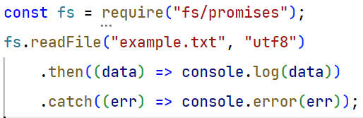
fs example (Promise)

Slide 27
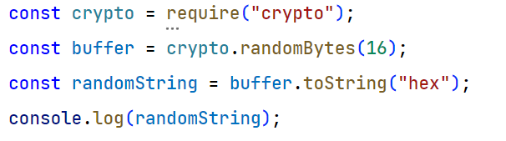
Crypto example

Slide 28
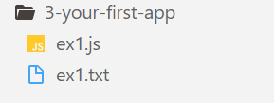
10 min task
Write to a file
You have the following file structure.
Inside ex1.js file you find a string.
Your task is to write the string into the ex1.txt file.
Hint: use writeFile function from fs module

Slide 29
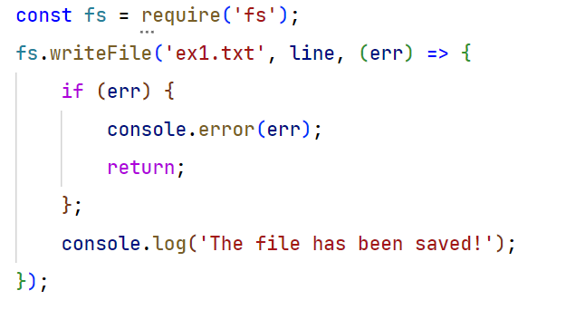
Answer

Slide 30
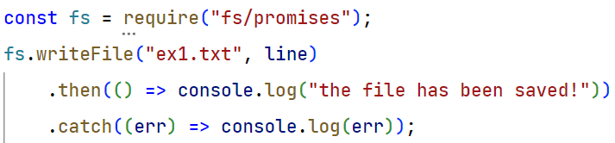
Answer

Slide 31
04
How JS works
The internals of JS

Slide 32
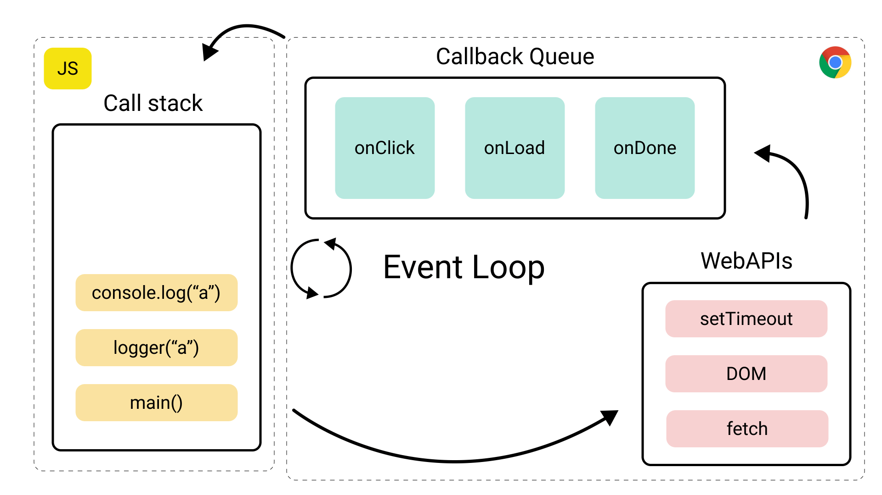
JS running on the browser
The engine

Slide 33

JS running on the browser
The JavaScript engine is the software that executes JavaScript code. It is responsible for parsing the code, converting it into machine code, and running it.
V8 This is the JavaScript engine developed by Google. It is used in Chrome, Node.js
SpiderMonkey developed by Mozilla. It is used in Firefox.
JavaScriptCore developed by Apple. It is used in Safari.
The V8 engine

Slide 34

JS running on the browser
The event loop is a loop that runs continuously in the background.
It checks for events that need to be handled and executes functions that are waiting to be executed.
If the stack is empty, the event loop will check if there are in the callback queues. If there are, it will execute them until the queue is empty.
If the stack is not empty, the event loop will wait until the stack is cleared before checking the queues again.
Event loop

Slide 35

JS running on the browser
Web APIs allow JavaScript code to interact with the web browser and the underlying operating system.
They provide access to features such as the DOM, the filesystem, and the network.
The DOM API: This API allows JavaScript code to interact with the Document Object Model (DOM), which is the underlying structure of a web page.
The Fetch API is a modern web API that allows JavaScript code to make HTTP requests to remote servers.
Web APIs

Slide 36

JS running on the browser

Slide 37

05
Package manager
NPM – What is package manager and why we use it

Slide 38

What is package manager?
A package manager is a tool that helps you to manage the dependencies of your Node.js project. Dependencies are the modules or libraries that your project needs to function properly.
For example, if you are building a web server, you might need a module that handles HTTP requests, such as Express. A package manager allows you to install, update, remove, and configure these dependencies.

Slide 39
Why we use it?
Share and reuse code:
Package managers usually have a registry where you can find and download thousands of packages that are created and maintained by other developers.
You can also publish your own packages to the registry and share them with the community.
For example, NPM is the default package manager for Node.js, and it has a registry with over 2 million packages that you can use for your project.

Slide 40
Steps to use npm
Open you new project directory.
Open your terminal.
Run “npm init”
Fill the questions.
Now you have your own package.

Slide 41
Use npm
Install package
Run “npm install <package-name>”
Uninstall package
Run “npm uninstall <package-name>”
Update package
Run “npm update <package-name>”

Slide 42
15 min task
Create a new package using NPM then:
Install lodash package
Create two arrays [1, 2, 3] and [2, 5, 1]
Use the function difference from lodash to get the elements in the first array that are not exist in the other array.

Slide 43

How to submit your assignment
Using your GitHub account create a new repository (session-1-assignment)
Drag and drop your code inside it.
Share the link or your repo with me.
Recommended courses for Git & GitHub
Paid course (English)
Free course ( Arabic)

Slide 44
Thank you

Slide 45
Extra readings

Slide 46
01
How Node.js works
The internals of Node.js

Slide 47
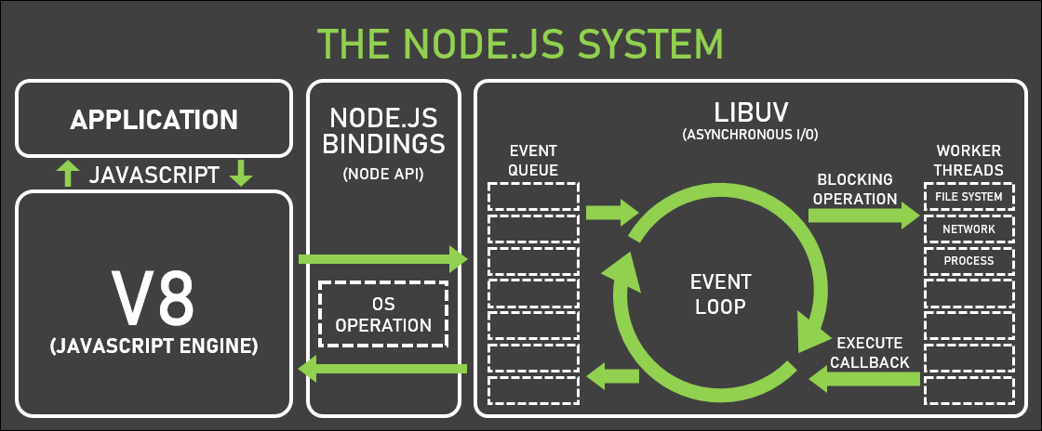
JS running on the server

Slide 48

JS running on the server xx
Node Bindings are the interfaces that connect your JavaScript code with the core modules of Node.js, such as fs, http, crypto, etc.
Allow you to use JavaScript to interact with the lower-level components of the system and its environment, such as the file system, the network, or the operating system.
Implemented in native code, such as C or C++, and exposed to JavaScript through a binding layer.
Mostly non-blocking, which means they do not block the main thread from executing other tasks while waiting for an operation to complete.
Node.js Bindings

Slide 49

JS running on the server xx
Libuv is a cross-platform C library that provides support for asynchronous I/O based on event loops.
Libuv is mainly used by Node.js to handle non-blocking operations from different operating systems, such as file system, network, or process events.
Libuv also offers various features and functions, such as TCP and UDP sockets, DNS resolution, thread pool, signal handling, and more.
libuv

Slide 50
02
Package manager
Why we use package manager

Slide 51
Why we use it?
Dependency hell:
Dependency hell is a situation where different parts of your project require different versions of the same module or library.
For example, if your project depends on module A, which depends on module B version 1.0, and module C, which depends on module B version 2.0, you might have a problem because module B version 1.0 and 2.0 are incompatible.
Package manager can help you to resolve these conflicts by using different strategies.

